Slide 1
INT252: Web App Development with ReactJS
Unit II – React Installation, JSX & Components
~AmAn pAl Singh

Slide 2
Unit II – Learning Objectives
By the end of this unit, you will be able to:
Install and configure React environment Understand React folder structure
Use JSX correctly
Create Class and Function components Apply styles in React

Slide 3
PART A: React Environment Setup
Prerequisites
Before installing React, ensure:
Basic JavaScript knowledge (Unit I) Laptop with Windows / Linux / macOS Internet connection

Slide 4

Step 1: Install Node.js
React needs Node.js and npm
Download from: https://nodejs.org/en/download Install from official
Verify Installation
Open terminal / command prompt:
node -v npm -v
If versions appear →
Installed correctly

Slide 5
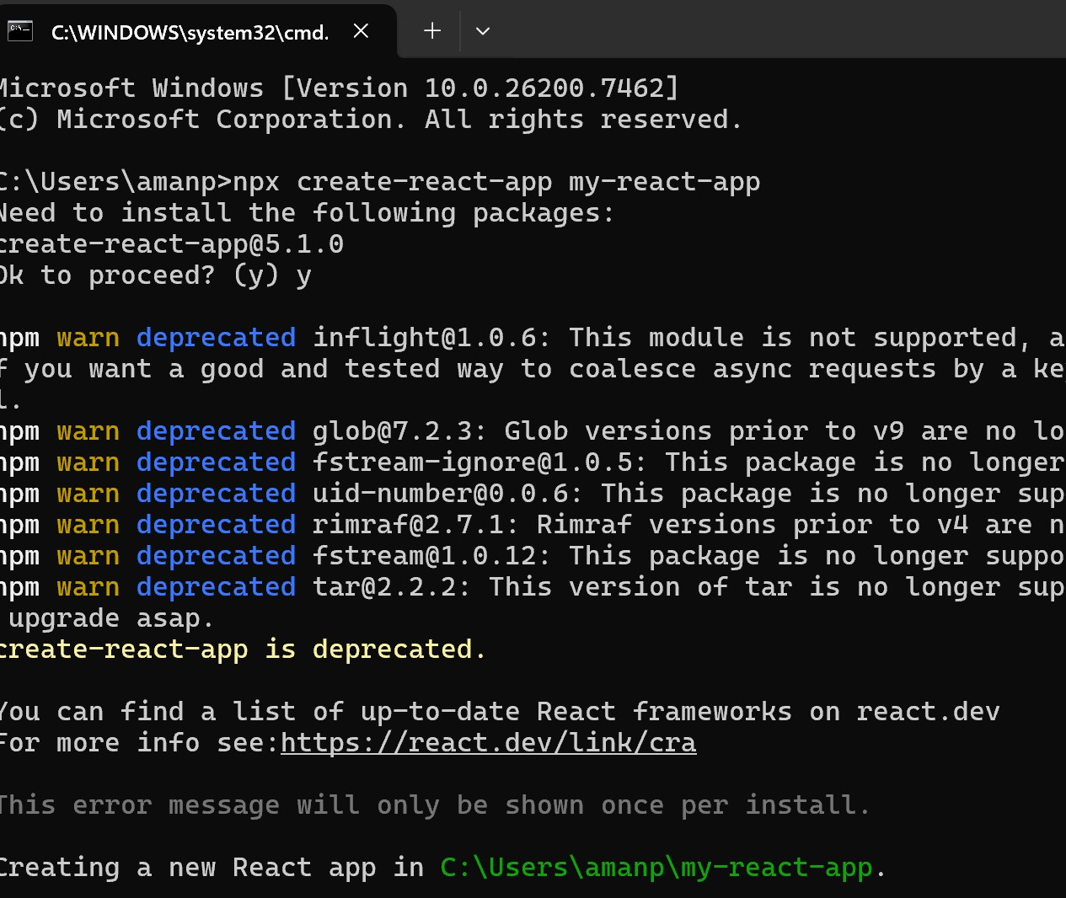
Step 2: Create React App
Use Create React App (CRA)
npx create-react-app my-react-app

Slide 6
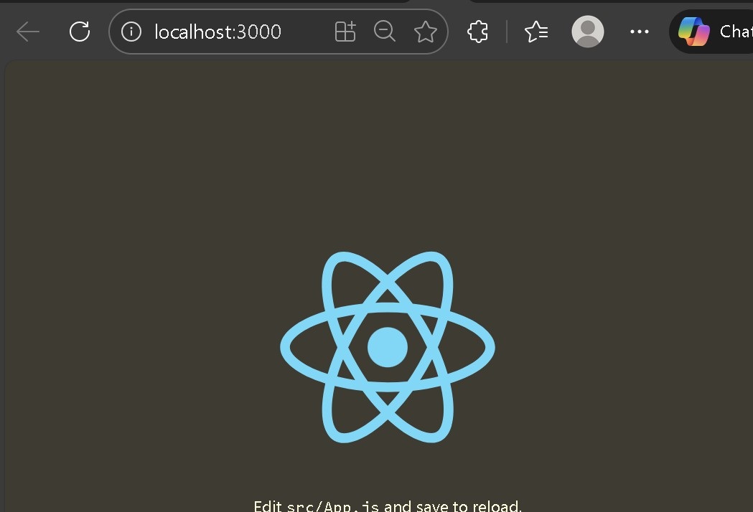
Step 3: Run React App
cd my-react-app npm start
Opens browser at
http://localhost:3000
Default React welcome page

Slide 7
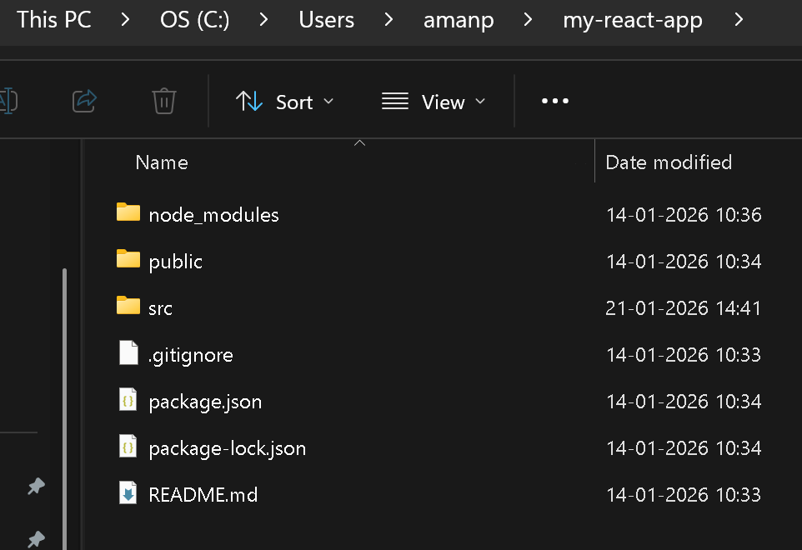
Folders
node_modules/
This directory contains all the project's dependencies (libraries and packages) installed via npm or yarn, as defined in package.json.
public/
This folder holds static assets that are served directly by the web server. This includes assets like images, the main HTML file (index.html), and the favicon.
src/
The "source" directory is where all the actual React application code resides.

Slide 8
Files
App.js
Serving as the main container or root component of the React application.
It typically renders other components and defines the main structure of the application's user interface.
index.js
Entry point for the JavaScript portion of the application.
It is the file where the root React component is "rendered" into the main HTML file (public/index.html), effectively starting the React application in the browser.
index.css
contains the global CSS styles for the entire application, applied to elements defined within index.js and other components.
package.json
This manifest file is crucial for managing the project.
It records the project's metadata, a list of dependencies (both for development and production), and scripts that can be used to run, build, or test the application.
10

Slide 9
Important Files Explained
index.js → Entry point
App.js → Main component
public/index.html
→ Single HTML page

Slide 10
React creates a VIRTUAL DOM in memory.
Instead of manipulating the browser's DOM directly, React creates a virtual DOM in memory, where it does all the necessary manipulating, before making the changes in the browser DOM.
React only changes what needs to be changed!
function App() {
return (
<div><h1>Hello, Aman!</h1></div>
);
}
export default App;

Slide 11
Replace/Update the content of the App.jsx file in the src folder:
function App() {
return (
<div><h1>Hello, Aman!</h1></div>
);
}
export default App;
Reference https://www.w3schools.com/REACT/react_first_app.asp

Slide 12
JSX vs React.createElement()
React.createElement( 'h1',
null,
'Hello React'
);
JSX is easier and preferred
const element = createElement(type, props, ...children)

Slide 13
JSX vs React.createElement()
What it is: A syntax extension for JavaScript that looks like HTML but compiles down to React.createElement() calls.
Why it’s used: It’s more readable and expressive. Developers can write UI components in a way that feels natural, like writing HTML.
App.js
import Test from './main';
import { createElement } from 'react';
function App() {
return (
<div>
<h1>Hello JSX!</h1>
<p>Welcome to 2026.</p>
</div>
);
}
export default App;

Slide 14
JSX vs React.createElement()
What it is: The underlying function that React uses to create virtual DOM elements.
Why it’s used: JSX is just syntactic sugar. When you write JSX, Babel (or another compiler) transforms it into React.createElement() calls.
App.js: equivalent to the JSX above
import React from 'react';
function App() {
return React.createElement(
'div',
null,
React.createElement('h1', null, 'Hello JSX!'),
React.createElement('p', null, 'Welcome to 2026.')
);
}
export default App;

Slide 15
createElement() argumets in different file
main.jsx
function Test({name}) {
return (
<div className="container">
<h1 style={{ color: 'blue' }}>Hello, {name}!</h1>
<p>Welcome to 2026.</p>
</div>
);
}
export default Test;
import Test from './main';
import { createElement } from 'react';
function App() {
return createElement(
'div',
null,
// Pass the Test parameter
createElement(Test, { name: "Aman" })
);
}
export default App;
App.js

Slide 16
PART B: JSX Fundamentals
JSX (JavaScript XML) is a syntax extension for JavaScript, popularized by React, that allows developers to write HTML-like structures directly within their JavaScript code
JavaScript + XML Makes UI code readable
Converted to JavaScript internally

Slide 17
JSX Example
JSX allows us to write HTML elements in JavaScript and place them in the DOM without any createElement() and/or appendChild() methods.
JSX converts HTML tags into react elements.
const element = <h1>Hello React</h1>;

Slide 18
JSX Rules
Must return single parent element Use className instead of class JavaScript inside { }
JSX does not run in the browser directly — it must be compiled After compilation, JSX becomes React.createElement() calls.
JSX is developer-friendly syntax, while React.createElement() is the raw API React uses internally.

Slide 19
JSX Expression / Variables Example
main.jsx
const name = "Aman";
const element = <h1>Hello {name}</h1>;
<p>It has {218 * 1.36} horsepower</p>
function Test({name}) {
const hp = 218 * 1.36;
return (
<>
<h1>My car</h1>
<p>It has {hp} horsepower</p>
</>
);
}
export default Test;
main.jsx

Slide 20
JSX Expression / Variables Example
main.jsx
function kwtohp(kw) {
return kw * 1.36;
}
function Test({name}) {
return (
<>
<h1>My car</h1>
<p>It has {kwtohp(218)} horsepower</p>
</>
);
}
export default Test;

Slide 21
Object Properties
function Test() {
const myobj = {
name: "Ford",
model: "500",
color: "white"
};
return (
<h1>My car is a {myobj.color} {myobj.name} {myobj.model}</h1>
);
}
export default Test;
main.jsx

Slide 22
React JSX Attributes
The class attribute is a much used attribute in HTML, but since JSX is rendered as JavaScript, and the class keyword is a reserved word in JavaScript, you are not allowed to use it in JSX.
JSX solved this by using className instead. When JSX is rendered, it translates className attributes into class attributes.
App.js
Or App.js
import React from 'react';
function App() {
return (
<h1 className="myclass">Hello World</h1>
);
}
export default App;
import React from 'react';
function App() {
const x = "myclass";
return (
<h1 className={x}>Hello World</h1>
);
}
export default App;
.myclass {
color: red;
}
App.css : Add this code

Slide 23
React JSX Attributes
App.js
import React from 'react';
import Car from './main.jsx';
function App() {
return (
<div>
{/* JSX usage */}
<Car />
{/* React.createElement usage with a DOM element */}
{React.createElement('p', null, 'Hii ')}
{/* React.createElement usage with a component */}
{React.createElement(Car, { brand: 'BMW' })}
</div>
);
}
export default App;

Slide 24
React Events
Just like HTML DOM events, React can perform actions based on user events.
React has the same events as HTML: click, change, mouseover etc.
React events are written in camelCase syntax: onClick instead of onclick.
React event handlers are written inside curly braces: onClick={myfunc} instead of onclick=“myfunc()".
main.jsx
App.js
function Car() {
const myfunc = () => {
alert('Hello World');
};
return (
<button onClick={myfunc}>Click me</button>
);
}
export default Car;
import Car from './main.jsx';
import React from 'react';
function App() {
return (
<div>
{React.createElement('p', null, Car())}
<p> <Car /> </p>
</div>
);
}
export default App;
Boolean Attributes
<button onClick={myfunc} disabled={true}>Click me</button>

Slide 25
React JSX if statement
main.jsx
App.js
function Fruit() {
const x = 5;
let y = "Apple";
if (x < 10) {
y = "Banana";
}
return (<h1>{y}</h1>);
}
export default Fruit;
import Fruit from './main.jsx';
function App() {
return (
<div>
<Fruit />
</div>
);
}
export default App;

Slide 26
PART C: Components in React
Reusable UI block
Can be function or class
Function Component (Recommended)
function Welcome() {
return <h1>Hello World</h1>;
}
export default Welcome;
Arrow Function Component
const Welcome = () => {
return <h1>Hello React</h1>;
};
export default Welcome;

Slide 27
Class Component
import React, { Component } from 'react';
class Welcome extends Component { render() {
return <h1>Hello Class Component</h1>;
}
}
export default Welcome;
Rendering Component in App.js
import Welcome from './Welcome';
function App() { return <Welcome />;
}
export default App;
23

Slide 28
hoisting
In React.js, hoisting works the same way as in plain JavaScript, because React components are just JavaScript functions or classes.
What is Hoisting?
Hoisting is JavaScript's default behavior of moving declarations to the top of their scope during the compilation phase.
Function declarations are hoisted with their definitions.
Variable declarations are hoisted, but initializations are not.
var variables are hoisted and initialized with undefined.
let and const are hoisted but remain in the Temporal Dead Zone (TDZ) until initialized.
Hoisting in React Components
1. Function Components (Declaration)
Function declarations are hoisted, so you can use them before they are defined.
23

Slide 29
Rendering a Component
App becomes the single entry point for your UI.
Inside App, you can include <Car /> (and other components later).
When you refresh, React re-renders <App />, which still contains <Car />.
function Car(props) {
return (
<h2>I am a {props.color} Car!</h2>
);
}
export default Car;
Arguments can be passed into a component as props, which stands for properties.
You send the arguments into the component as HTML attributes.
main.jsx
App.js
import Car from './main.jsx';
import { createRoot } from 'react-dom/client'
function App() {
return (
<div>
<Car color="red" />
</div>
);
}
createRoot(document.getElementById('root')).render(<App />);
export default App;

Slide 30
React components must return one root element
function App() {
return (
<div>
{/* children go here */}
</div>
);
}
export default App;
React requires that the return statement evaluates to a single element. That element can have children, but there must be one “root” wrapper.
If you try to return two siblings side by side without a wrapper:
function App() {
return (
<h1>Hello</h1>
<p>World</p>
);
}
export default App;
We’ll get a syntax error because JSX doesn’t allow multiple top-level elements without a parent
By wrapping everything inside <div>...</div>, you’re giving React one root element to return. Inside that <div>, you can place as many children as you want.

Slide 31
Alternatives to <div> : React Fragments
If you don’t want an extra <div> in the DOM, you can use React Fragments:
function App() {
return (
<>
<h1>Hello</h1>
<p>World</p>
</>
);
}
export default App;
<>...</> is shorthand for <React.Fragment>...</React.Fragment>. It satisfies React’s “one root element” rule but doesn’t add an extra wrapper in the DOM.

Slide 32
React Fragments
React.Fragment is a built-in React component that lets you group a list of child elements without adding an extra, unnecessary node to the Document Object Model (DOM).
This is a solution to the requirement that a React component must return a single root element.
Full Syntax Shorthand Syntax
function Component() {
return (
<Fragment>
<h1>Title</h1>
<p>Some text here.</p>
</Fragment>
);
}
function Component() {
return (
<>
<h1>Title</h1>
<p>Some text here.</p>
</>
);
}

Slide 33
React Fragments advantages
Fragments help maintain a clean and efficient DOM structure.
Cleaner DOM: Prevents "div soup" (excessive, unnecessary <div> nesting) in your HTML output.
Improved Performance: Fewer DOM nodes mean less memory usage and potentially faster rendering times, especially in large, complex applications.
Valid HTML Structure: Essential for maintaining valid HTML for elements with strict parent-child relationships, such as tables (where a <tr> must be a direct child of a <table> or <tbody>, not a <div>) or lists.
Maintains Styling: Avoids layout issues caused by extra wrapper elements when using CSS layout mechanisms like Flexbox or CSS Grid.

Slide 34
Components in Components
Use the Car component inside the Garage component:
function Car() {
return (
<h2>I am a Car!</h2>
);
}
function Garage() {
return (
<>
<h1>Who lives in my Garage?</h1>
<Car />
</>
);
}
export default Garage;
import Garage from './main.jsx';
function App() {
return (
<div>
<Garage />
</div>
);
}
export default App;
App.js
main.jsx

Slide 35
Use the Car component to display two different cars:
function Car(props) {
return (
<h2>I am a {props.brand}!</h2>
);
}
function Garage() {
return (
<>
<h1>Who lives in my Garage?</h1>
<Car brand="Ford" />
<Car brand="BMW" />
</>
);
}
export default Garage;

Slide 36
React Class Components
Before React 16.8, Class components were the only way to track state and lifecycle on a React component.
Function components were considered "state-less".
With the addition of Hooks, Function components are now almost equivalent to Class components.
The differences are so minor that you will probably never need to use a Class component in React.
Even though Function components are preferred, there are no current plans on removing Class components from React.

Slide 37
Class Car component :
main.jsx
App.js
import React from 'react';
class Car extends React.Component {
render() {
return <h2>Hi, I am a Car!</h2>;
}
}
export default Car;
import Car from './main.jsx';
function App() {
return (
<div>
<Car />
</div>
);
}
export default App;
When creating a React component, the component's name must start with an upper case letter.
The component has to include the extends React.Component statement, this statement creates an inheritance to React.Component, and gives your component access to React.Component's functions.

Slide 38
React Destructuring Props
The component receives all the properties, but uses destructuring to limit the properties inside the component.
You can also destruct the properties you need inside the component.
This way, the component receives all the properties, but the destructuring makes sure it only uses the ones it needs.
main.jsx
App.js
function Car(props) {
const {brand, model} = props;
return (
<h2>I love my {brand} {model}!</h2>
);
}
export default Car;
import Car from './main.jsx';
function App() {
return (
<div>
<Car brand="Ford" model="Mustang" color="red" year={1969} />
</div>
);
}
export default App;

Slide 39
React Props Children
main.jsx
function Fun1(props) {
return (
<div style={{background: 'lightgreen'}}>
<h2>Son</h2> <div>{props.children}</div>
</div>
); }
function Fun2(props) {
const {brand, model} = props;
return (
<div style={{background: 'lightblue'}}>
<h2>Daughter</h2> <div>{props.children}</div>
</div>
); }
function Parent() {
return (
<div>
<Fun1><p>Written in the Parent component, from Son component</p></Fun1>
<Fun2><p>Written in the Parent component, from Daughter component</p></Fun2>
</div>
);
}
export default Parent;
App.js
import Parent from './main.jsx';
function App() {
return (
<div>
<Parent />
</div>
);
}
export default App;
In React, you can send the content between the opening and closing tags of a component, to another component.
This can be accessed in the other component using the props.children property.

Slide 40
React Conditional Rendering
In React, you can conditionally render components.
main.jsx
App.js
function Goal(props) {
const isGoal = props.isGoal;
if (isGoal) {
return <MadeGoal/>;
}
return <MissedGoal/>;
}
export default Goal;
function MadeGoal() {
return <h1>Goal!</h1>;
}
function MissedGoal() {
return <h1>Missed!</h1>;
}
import Goal from './main.jsx';
function App() {
return (
<div>
<Goal isGoal={true} />
</div>
);
}
export default App;

Slide 41
Rendering Elements into DOM
Use the createRoot method from react-dom/client.
This process involves creating a root DOM node which React will manage and then rendering a React element (typically JSX) into it.
React Elements: These are plain JavaScript objects that describe what you want to see on the screen. They are not actual DOM elements but light-weight descriptions.
Root DOM Node: This is the actual HTML element in your index.html file that serves as the container for your entire React application or a part of it. A typical React app has a single root node, often with the ID of root.
Virtual DOM: React uses a virtual DOM, an in-memory representation of the real DOM. When data changes (via state or props updates), React compares the new virtual DOM with the previous one (a process called diffing) and only applies the necessary, minimal changes to the real DOM. This makes rendering efficient.

Slide 42
Step-by-Step Rendering Process
Create a Root: Use createRoot to identify the "root" DOM node in your HTML where the application will live.
Render the Element: Call the .render() method on that root, passing the React element (often written in JSX).
import { createRoot } from 'react-dom/client';
function App() {
// 1. Identify the container in the HTML
const domNode = document.getElementById('root');
// 2. Create the React root
const root = createRoot(domNode);
// 3. Create a React element
const element = <h1>Hello, world</h1>;
// 3. Render the element
root.render(element);
return (<></>);
}
export default App;
App.js
React 18, the recommended API is createRoot from react-dom/client.

Slide 43
Challenge: calculation with function in App in ReactJS.
App.js
main.jsx
import {Add,Subtract,Divide,Multiply} from "./code";
/* Challenge:
Create calculator App in ReactJS.
*/
function App() {
return (
<>
<ol>
<li>{Add(30,5)}</li>
<li>{Subtract(30,5)}</li>
<li>{Divide(30,5)}</li>
<li>{Multiply(30,5)}</li>
</ol>
</>
);
}
export default App;
function Add(a,b)
{ return a+b;};
function Subtract(a,b)
{ return a-b;};
function Divide(a,b)
{return a/b;};
function Multiply(a,b)
{ return a*b;};
export {Add,Subtract,Divide,Multiply};

Slide 44
JSX Comments Between elements
JSX is an extension of JavaScript: Anything inside the curly braces {} is treated as a JavaScript expression.
This is why the standard JavaScript block comment syntax /* ... */ works when wrapped in braces.
Do not use HTML comments: Standard HTML comments (<!-- ... -->) will be parsed as text and displayed in your application, or cause a compilation error.
function App() {
return (
<>
<h1 style={{ color: 'blue' }}>1. Inline Styling</h1>
{/* The two layers of {}:
Outer {}: In JSX, this indicates that we are embedding a JavaScript expression.
Inner {}: The style prop expects a JavaScript object.
*/} </>
);
}

Slide 45
PART D: Styling in React
1. Inline Styling
<h1 style={{ color: 'blue' }}>Hello</h1>
2. CSS Stylesheet
3. CSS Modules
/* App.css */
.title {
color: green;
}
/* App.module.css */
.title { color: red; }
import styles from './App.module.css';
<h1 className={styles.title}>Hello</h1>
<h1 className="title">Hello</h1>
4. Adding Bootstrap
npm install bootstrap
import 'bootstrap/dist/css/bootstrap.min.css';
26
27
28

Slide 46
App.js
import './App.css';
import './index.css';
function App() {
return (
<>
<h1 style={{ color: 'blue' }}>1. Inline Styling</h1>
{/* The two layers of {}:
Outer {}: In JSX, this indicates that we are embedding a JavaScript expression.
Inner {}: The style prop expects a JavaScript object.
*/}
<h2 className="h2">2. CSS Stylesheet App.css</h2>
<h3 className="h3">3.CSS Stylesheet index.css </h3>
</>
);
}
export default App;
scr/index.css
App.css
.h2 {
color:green;
}
.h3 {
color: red;
}

Slide 47
index.css vs App.css
In a React application, index.css is typically used for global styles that apply across the entire application,
while App.css is intended for styles specific to the main App component and its immediate layout. The distinction is mainly a convention for organizing code rather than a technical requirement imposed by React itself.
Feature | index.css | App.css
Scope | Global; styles affect all components throughout the app. | Component-specific; styles primarily affect the App component and its children within that component's scope.
Import Location | Imported in index.js (the application's entry point file), ensuring styles are loaded before the main app component renders. | Imported directly within the App.js file.
Purpose | Used for foundational rules, such as CSS resets, global typography settings, base colors, and general layout rules for top-level container elements (like the body or the root div). | Used for styling the main container, primary navigation, or other layout aspects specific to the top-level App component.

Slide 48
PART E: Virtual DOM & Props
React Virtual DOM
Lightweight copy of real DOM
Updates only changed parts
Improves performance
Props (Properties)
Used to pass data to components
Read-only

Slide 49
Passing parameters in React.createElement()
Code.jsx
function Greeting({name}) {
return (
<div className="container">
<h1 style={{ color: 'blue' }}>Hello, {name}!</h1>
<p>Welcome to 2026.</p>
</div>
);
}
export default Greeting;
App.js
import './App.css';
import Greeting from './code';
import { createElement } from 'react';
function App() {
return createElement(
'div',
null,
// Pass the 'name' parameter as the second argument
createElement(Greeting, { name: "Aman" })
);
}
export default App;
Passing parameters in JSX
App.js
import './App.css';
import Greeting from './code';
function App() {
return <Greeting name="Amanpal"/>;
}
export default App;

Slide 50
Props Example
function Greeting(props) {
return <h1>Hello {props.name}</h1>;
}
<Greeting name="Aman" />

Slide 51
Props with Destructuring
// Car.jsx
function Car({ color, brand }) {
return <h2>I am a {color} {brand} car!</h2>;
}
export default Car;
// App.jsx
import Car from "./Car";
function App() {
return (
<div>
<Car color="blue" brand="Tesla" />
<Car color="red" brand="BMW" />
</div>
);
}
export default App;
function Greeting({ name }) { return <h1>Hello {name}</h1>;
}
Why destructuring is useful
Makes code shorter and easier to read.
Lets you see exactly which props a component expects.
Avoids repeatedly writing props. everywhere.

Slide 52
Unit II Summary
React environment setup JSX understanding
Function & Class components Styling techniques
Props usage

Slide 53
Next Unit
Unit III: Hooks, State & Lifecycle
useState, useEffect
Events & State management

